Slide 1
Exchange Rate
Gopal Maliwal

Slide 2
Meaning & Introduction
Exchange rate refers to the price of a nation’s currency in terms of another nation’s currency. In other words, the domestic currency is expressed in terms of the foreign currency.
For example, on 1st December 2020, 1 Dollar was equal to Rs.73.66. This means that a person can buy goods worth Rs. 73.66 using 1 U.S. Dollar (USD) or vice versa.

Slide 3
Exchange rate is an important factor that determines the country’s economic condition. It allows the country to trade with other countries. When the value of the foreign currency increases, imports become expensive and exports become cheaper.
Similarly, when the price of the foreign currency reduces, the imports become cheaper and exports become expensive.
Therefore, a higher exchange rate can lower the country’s balance of trade and a lower exchange rate can improve it.

Slide 4
In theory terms exchange rate determination is explained by two main models:
Flexible/floating exchange rate model
2. Fixed/pegged exchange model

Slide 5
Flexible Exchange Rate Model
In a flexible exchange rate system, the currency’s value is allowed to fluctuate according to the foreign exchange market. There is no intervention by the government or the central bank.
When we treat exchange as a price of any foreign currency, then we can use the tools of demand and supply to determine this ‘price’.
Foreign exchange is treated as a ‘good’ with its own demand and supply curves as we learnt in Micro­economics course. Any shifts in each or both of these curves will deter­mine the changes in price of foreign exchange.

Slide 6
Demand for Foreign Exchange:
Any transaction that leads to outflow of foreign exchange from India will create a demand for it.
Foreign exchange is demanded when residents of India (in terms of in­dividuals or private companies) and government want to spend in terms of foreign currency, instead of Rupees.
If a non-resident provides any service, He/She must be paid dollars by the Indian employer, which adds to demand for dollars.

Slide 7
Demand of foreign currency is created in following ways:
Indian importers who want to buy capital goods from USA must pay the manufacturers in dollars.
Non-residents who provide services in India must be paid in dol­lars. For example, when you buy premium service of ZOOM then you must have to pay in dollars.
Foreign companies that set up production in India will send profits to home country in dollar terms. This is also called profit repatriation.

Slide 8
(iv) If an Indian parent wants to send money to their children studying in the US, they need dollars.
(v) NRI’s withdraw the money from the special account where they deposited money in foreign currency.
(vii) Indian citizen invest in foreign capital/money market.

Slide 9
Supply of Foreign Exchange:
Any transaction that leads to an inflow of foreign exchange will gen­erate supply of it.
Foreign exchange is supplied when non-residents (in terms of individuals or private companies) and government want to spend in terms of Indi­an rupees. For this they provide supply foreign currency to banks and receive Indian rupees

Slide 10
Supply of foreign currency is created in following ways:
Indian Exporters sells to goods to USA receives payment in dollars.
Residents of India who provide services to foreign companies are paid in non rupee currency. When they want to spend in India they convert their income into Indian rupees, providing India with supply of foreign exchange.
Indian companies that set up production outside India will send profits to India in dollar terms, which is part of supply of dollars.

Slide 11
(iv) If foreign parents want to send money to their children studying in the India, they need to convert the foreign currency into INR.
(v) If a foreigner or (from USA) wants to buy shares of an Indian company she will have to pay in rupee terms, creating a supply of dollars. This kind of investment is also possible in Indian mu­tual funds, stock markets and other financial instruments. This financial investment by non-residents of India generates a supply of dollars.

Slide 12
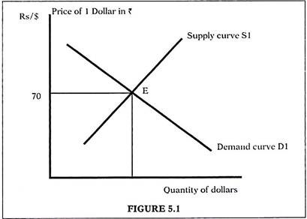
In figure 5.1, on the X axis we have quantity of foreign exchange (or Dollars, as we treat it as the foreign currency as compared to domestic currency Rupee). The Y axis denotes the price of 1 dollar in Rs. terms. The commodity depicted here is ‘foreign exchange’ (dollars in this case).
As shown we have a downward sloping demand curve for dollars. This implies that as the price of a dollar in Rs. terms falls the demand for dollars will rise. This is the same logic that we use for any other good. The law of demand gives us an inverse relation between price and quantity of any good, represented as a down sloping demand curve.

Slide 13
The supply curve is upward sloping, implying that as price of $ 1 rises its supply will increase. Equilibrium is found at the point where demand= supply. At E, $ 1 = Rs.70 and this is the market determined equilibrium Exchange Rate for dollars.
A model as shown in figure 5.1 lies at the core of flexible exchange rate model.

Slide 14
As the name suggests, in this model the exchange rate is flexible, as it changes in response to changes in demand and supply of foreign cur­rency. Any factor that directly or indirectly affects demand/supply will cause exchange rate to change.
There is no government intervention in this model.
Buyers and sellers are ‘free’ to buy and sell any quantity of foreign exchange – there is no limit on this quantity.

Slide 15
Depreciation & Appreciation of Exchange Rate
Depreciation of domestic currency refers to an increase in the domestic price of foreign exchange.
Appreciation of domestic currency refers to a fall in the domestic price of foreign exchange.

Slide 16
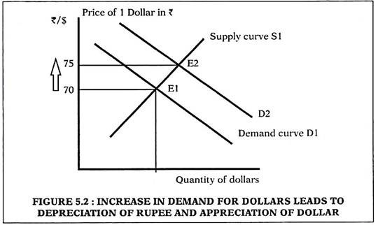
A. Increase in Demand for Dollars
Let us start at equilibrium at point E1 where demand = supply of foreign exchange and equilibrium exchange rate is 1 $ = Rs.70 in figure 5.2. A rise in demand for dollars is shown as a rightward shift of demand curve from D1 to D2. The new equilibrium is now at E2, where exchange rate is Rs.75 for $ 1. This may happen when imports rise and importers need dollars to pay for goods bought from abroad. This change is also called depreciation of the Rupee.

Slide 17
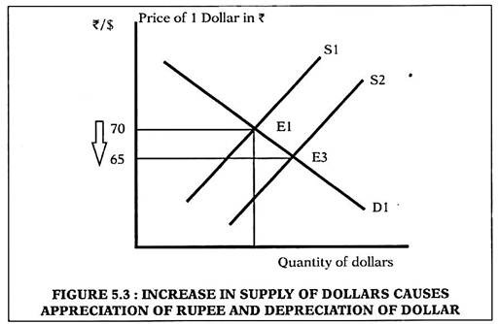
B. Increase in Supply of Dollars
Let us start again at equilibrium at point E1 where demand = supply of foreign exchange and equilibrium exchange rate is 1 $ = Rs.70 in figure 5.3. An increase in supply of dollars is shown as a rightward shift of supply curve from SI to S2. The new equilibrium is now at E3, where exchange rate is Rs.65 for $1.
This may happen when exports rise and sellers from abroad need to pay Indian exporters in Rupee terms. To do so they must supply more foreign ex­change to Indian banks in return for Rupees. This change from Rs.70 to Rs.65 is also called appreciation of the Rupee.

Slide 18
C. Simultaneous Increase in Demand and Supply of Dollars
Let us start at equilibrium at point E1 where demand = supply of foreign exchange and equilibrium exchange rate is 1 $ = Rs.70 in figures 5.4A, 5.4B and 5.4B. We now allow both demand and supply to change. This is shown by a simultaneous move from D1 to D2 (depicting increase in demand for foreign exchange) and from S1 to S2 (depicting increase in supply for foreign exchange).

Slide 19
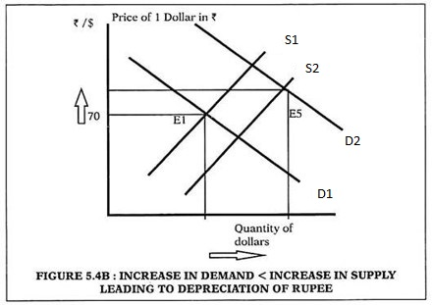
When Change in demand is more than change in supply
Figure 5.4A- A move from E1 to E5, causing an depreciation of the Rupee. This happens if increase in demand of Dollar is more than the increase in supply of Dollar . This is clearly shown as the amount of shift of D1→D2 exceeds the shift of S1→S2.
Refer : https://www.yourarticlelibrary.com/macro-economics/balance-of-payment/changes-in-exchange-rate-change-in-demand-and-change-in-supply/30430

Slide 20
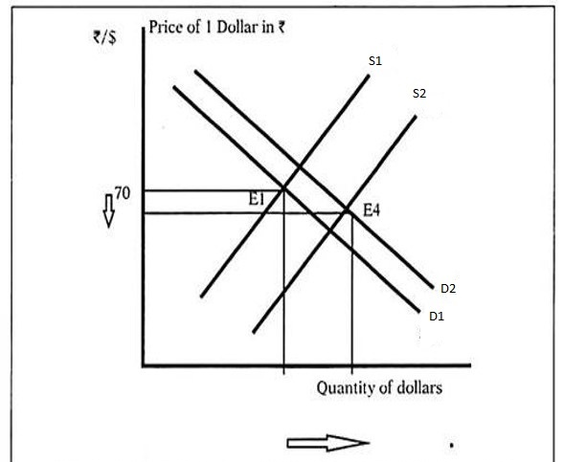
When Change in Supply is more than change in Demand
Figure 5.4B- A move from E1 to E4, causing Appreciation of the Rupee. This happens if increase in supply of Dollar is more than the increase in Demand of Dollar. . This is clearly shown as the amount of shift of D1→D2 exceeds the shift of S1→S2.
Refer : https://www.yourarticlelibrary.com/macro-economics/balance-of-payment/changes-in-exchange-rate-change-in-demand-and-change-in-supply/30430

